Slide 1


CCNP SWITCH v7.1
Chapter 5: Inter-VLAN Routing

Slide 2
Chapter 5 Objectives
Given an enterprise network, design, implement, and verify inter-VLAN routing using an external router or a multilayer switch, using either switch virtual interfaces or routed interfaces.
Understand Layer 3 EtherChannel and its configuration.
Understand DHCP operation and its implementation and verification in a given enterprise network.
Notes:
Chapter 4 Objectives

Slide 3

Describing Inter-VLAN Routing

Slide 4
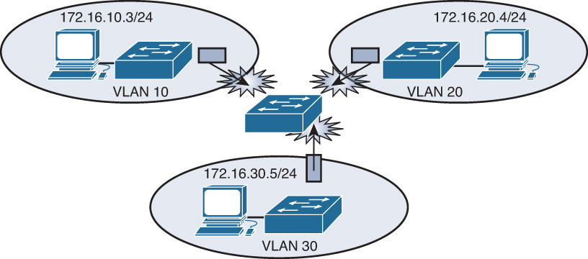
Introduction to Inter-VLAN Routing
VLANs isolate traffic by design.
Inter-VLAN router of some sort required.
Inter-VLAN routing should occur in the distribution layer.
Multilayer switch is recommended to terminate VLANs.

Slide 5
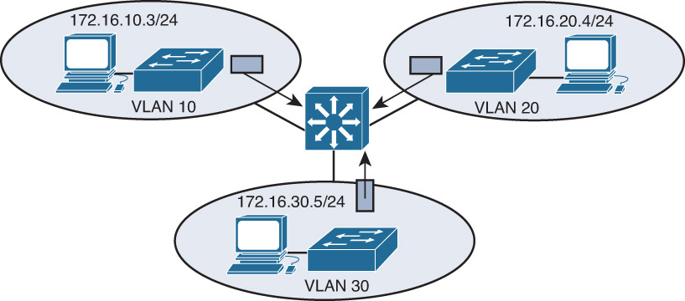
Inter-VLAN Routing Options
The following devices can provide inter-VLAN routing
Any Layer 3 multilayer Catalyst switch.
Any external router with an interface that supports trunking (router-on-a-stick).
Any external router or group of routers with a separate interface in each VLAN
Notes:
Adding an external router with an individual interface in each VLAN is a nonscalable solution, especially when between 20 and 50 VLANs exist in the network. In addition, adding an external router for inter-VLAN routing on trunk interfaces does not scale beyond 50 VLANs. This chapter discusses only using Layer 3 switches and external routers with trunk interfaces (router-on-a-stick) to route VLANs. Furthermore, Cisco IOS routers support trunking in specific Cisco IOS Software feature sets, such as the IP Plus Feature set. Refer to the documentation on Cisco.com for software requirements before deploying inter-VLAN routing on Cisco IOS routers.
Router-on-a-stick is simple to implement because routers are usually available in every network, but most enterprise networks use multilayer switches to achieve high packet processing rates using hardware switching. In addition, Layer 3 switches usually have packet-switching throughputs in the millions of packets per second (pps), whereas traditional general-purpose routers provide packet switching in the range of 100,000 pps to more than 1 million pps. Router-on-a-stick in modern networking is mostly useful as a means of explaining inter-VLAN routing operation.

Slide 6
Catalyst Switch Layer 3 Interfaces
All the Catalyst multilayer switches support three different types of Layer 3 interfaces:
Routed port: A pure Layer 3 interface similar to a routed port on a Cisco IOS router.
Switch virtual interface (SVI): A virtual VLAN interface for inter-VLAN routing. In other words, switch virtual intefaces (SVIs) are virtual routed VLAN interfaces.
Bridge virtual interface (BVI): A Layer 3 virtual bridging interface. Used in some DSL applications, but not used much any more since bridging protocols across interfaces is no longer necessary.
Notes:
Because of high-performance switches such as the Catalyst 6500 and Catalyst 4500, almost every function, from spanning tree to routing, is done through hardware switching using features such as MLS and Cisco Express Forwarding (CEF)-based MLS, both of which are discussed in detail in later sections of this chapter. All Layer 3 Cisco Catalyst switches support routing protocols, but several models of Catalyst switches require enhanced software for specific routing protocol features.

Slide 7
Catalyst Switch Layer 3 Interfaces
Type of Switch | Inter-VLAN Routing Capability | Inter-VLAN Routing Solution
Catalyst 2940/2950/2955/2960/2970 | No | –
Catalyst 3560/3750/3760 | Yes | Yes - SVIs
Catalyst 4000/4500/4948 | Yes | Catalyst 4000 with a Supervisor II+, III, IV, or V running Cisco IOS using integrated routing
Catalyst 6500 | Yes | Catalyst 6500 with an MSFC, MSFC II, or MSFC III daughter card running Cisco CatOS on the supervisors and Cisco IOS on the MSFC Catalyst 6500 with MSFC, MSFC II, or MSFC III running Cisco Native IOS Catalyst 6500 using a legacy MSM
Notes:
The table lists the Catalyst switches and their capabilities to support Layer 3. Catalyst switches use different default settings for interfaces. For example, all members of the Catalyst 3550 and 4500 families of switches use Layer 2 interfaces by default, whereas members of the Catalyst 6500 family of switches running Cisco IOS use Layer 3 interfaces by default. Recall that default interface configurations do not appear in the running or startup configuration. As a result, depending on which Catalyst family of switches is used, the switchport or no switchport command might be present in the running-config or startup-config files.
The default configurations do not appear in the running or start-up config. For some Cisco switches, the switchport command is the default config and for others the no switchport command is the default config.

Slide 8
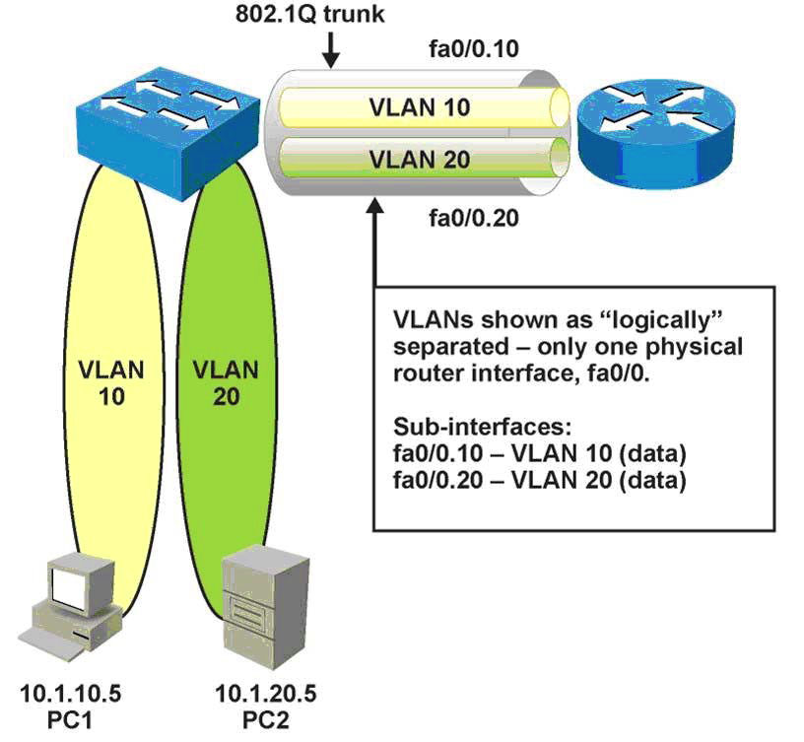
Inter-VLAN Routing Using an External Router
Layer 2 switch linked to router via trunk (in lieu of using a multilayer switch).
Router interface, typically Fast Ethernet, subdivided into logical subinterfaces, one per VLAN.
In the diagram, is connected to a core switch using a single 802.1Q trunk that carries VLAN 10 and 20. This is commonly referred to as router-on-a-stick.
Notes:
If a switch supports multiple VLANs but has no Layer 3 capability to route packets between those VLANs, the switch must be connected to a device external to the switch that possesses this capability. This setup is not a high performance solution but it is quite simple. It just needs a single trunk link between the switch and the router. This single physical link should be Fast Ethernet or greater, although 802.1Q is supported on some 10-Mb Ethernet interfaces.
The figure shows a configuration where the router is connected to a core switch using a single 802.1Q trunk link. This configuration is commonly referred to as router-on-a-stick. The router can receive packets on one VLAN, for example on VLAN 10, and forward them to another VLAN, for example on VLAN 20. To support 802.1Q trunking, subdivide the physical router interface into multiple, logical, addressable interfaces, one per VLAN. The resulting logical interfaces are called subinterfaces.
Assume that client PC-1 needs to send traffic to server PC-2. Because the hosts are on different VLANs, transferring this traffic requires a Layer 3 device. In this example, an external router connects to the switch via an 802.1Q trunk—a router-on-a-stick.
The frame is transmitted by the source device and enters the switch where it is associated with a specific VLAN.
The switch determines (from the destination MAC address) that the frame must be forwarded across a trunk link. It adds an 802.1Q tag to the frame header and forwards to the router.
Based on the 802.1Q tag received, the router accepts the packets from VLAN10 on its subinterface in that VLAN. The router performs Layer 3 processing based on the destination network address. Because the destination network is associated with a VLAN accessed over the trunk link, the router adds the appropriate 802.1Q tag to the frame header.
The router then routes the packet out the appropriate subinterface on VLAN20.
The switch removes the 802.1Q tag from the frame. The switch determines from the destination MAC address that the frame will be transmitted through an access mode port in VLAN 20, so the frame is transmitted as an untagged Ethernet frame.
External Router: Advantages and Disadvantages
Every method of inter-VLAN routing has it advantages and disadvantages. The following are the advantage of the router-on-a-stick method:
It works with any switch that supports VLANs and trunking because Layer 3 services are not required on the switch. Many switches do not contain Layer 3 forwarding capability, especially switches used at the access layer of a hierarchical network. If using Local VLANs, mostly none of the switches at the access layer have Layer 3 forwarding capability. Depending on the network design, it might be possible to have no Layer 3-capable switches at all.
The implementation is simple. Only one switch port and one router interface require configuration. If the switch enables all VLANs to cross the trunk (the default), it literally takes only a few commands to configure the switch.
The router provides communication between VLANs. If the network design includes only Layer 2 switches, this makes the design and troubleshooting traffic flow simply because only one place in the network exists where VLANs inter-connect.
The following are some of the disadvantages of using the external router for inter-VLAN routing:
The router is a single point of failure.
A single traffic path may become congested. With a router-on-a-stick model, the trunk link is limited by the speed of the router interface shared across all trunked VLANs. Depending on the size of the network, the amount of inter-VLAN traffic, and the speed of the router interface, congestion could result with this design.
Latency might be higher as frames leave and re-enter the switch chassis multiple times and the router makes software-based routing decisions. Latency increases any time traffic must flow between devices. Additionally, routers make routing decisions in software, which always incurs a greater latency penalty than switching with hardware.

Slide 9
Configuring Router-on-a-Stick
Step 1. Enable trunking on the switch port.
Switch(config-if)# switchport trunk encapsulation dot1q
Switch(config-if)# switchport mode trunk
Switch(config-if)# switchport trunk native vlan #
Step 2. Enable the router interface.
Router(config-if)# no shutdown
Step 3. Create the subinterfaces for each VLAN that requires inter-VLAN routing.
Router(config)# interface interface_id slot/port.subinterface
Step 4. Configure the trunking encapsulation and IP address on the subinterfaces corresponding to the VLANs.
Router(config-subif)# encapsulation [dot1q | isl] vlan-id {native}
Router(config-subif)# ip address ip_address subnet_mask
Notes:
Before implementing inter-VLAN routing, a network engineer should plan the steps necessary to make it successful.
Implementation Planning
Prior planning can help reduce any problems during the installation by logically organizing the steps necessary and providing checkpoints and verification, as necessary. Following are the key points to plan the implementation for the external router configuration method:
You need to know how many VLANs need routing and their VLAN_Ids. In addition, know what ports connect to the router.
A router interface providing inter-VLAN routing on a trunk link must be configured with a subinterface for each VLAN for which it will perform routing. Each subinterface on the physical link must then be configured with the same trunk encapsulation protocol. That protocol, usually 802.1Q (many Cisco switches also support the ISL protocol, but it is considered legacy technology), must match the encapsulation type configured on the switch side of the link, so you need to know the type of encapsulation.
Make sure to have the same native VLAN on both devices. Because traffic on the native VLAN is not tagged, all native VLAN frames will be received as untagged Ethernet frames. Beginning with Cisco IOS version 12.1(3)T, the creation of a subinterface for the native VLAN is allowed. If the native VLAN is configured as a subinterface, the command encapsulation dot1q <vlan> native is used. With older IOS versions, the physical interface is configured as the gateway for the native VLAN, with no encapsulation command—just an IP address. All other, non-native VLANs have an 802.1Q tag inserted into their frames. These non-native VLANs are configured as subinterfaces on the router, and the VLANs must be defined as using 802.1Q encapsulation, with the VLAN associated with them being identified. The subinterface command encapsulation dot1q vlan accomplishes this task.
Note: The subinterface number of the slot/port number configuration is arbitrary and does not need to match the encapsulation configuration. However, to make configuration easily readable, configure the subinterface ID number as the VLAN ID number.
Because a switch port defined as a trunk forwards all Ethernet VLANs by default, no configuration is required on the switch for the non-native VLANs. Additional configuration might exist if the trunk is configured to enable only some VLANs to use the trunk.

Slide 10
Router-on-a-Stick Example
Here, VLAN 100 is used as native VLAN. It is a security best practice to use a unused data VLAN for the native VLAN.
Router(config)# interface FastEthernet0/0
Router(config-if)#no shutdown
Router(config-if)# interface FastEthernet 0/0.100
Router(config-subif) description VLAN 100
Router(config-subif)# encapsulation dot1q 100 native
Router(config-subif)# ip address 10.1.100.1 255.255.255.0
Router(config-subif)# exit
Router(config)# interface FastEthernet 0/0.2
Router(config-subif)# description VLAN 2
Router(config-subif)# encapsulation dot1q 2
Router(config-subif)# ip address 10.1.2.1 255.255.255.0
Router(config-subif)# exit
Router(config)# end
#####Cisco IOS switch Trunking Configuration Connected to Interface FastEthernet0/0
Switch(config)# interface FastEthernet 4/2
Switch(config-if)# switchport trunk encapsulation dot1q
Switch(config-if)# switchport mode trunk
Switch(config-if)# switchport trunk native 100
Switch(config-if)# end
Notes:
Here is an example of configuring inter-VLAN routing between VLAN 1 and VLAN 2 on an external router on the interface FastEthernet0/0 and a Catalyst switch running Cisco IOS on interface FastEthernet 4/2. Configuration of a router is followed by the switch configuration to configure an interface as a trunk port.
The encapsulation dot1q 1 native command was introduced in Cisco IOS version 12.1(3)T. The native keyword indicates the native VLAN. Recall from Chapter 2 that Cisco switches and routers do not tag the native VLAN. The alternative method of configuring the native VLAN is to configure the Layer 3 properties, such as the IP address, on the main interface rather than on the subinterface – however, experience shows that this often causes unnecessary complications, so strictly using subinterfaces in this context is recommended.

Slide 11
External Routers: Advantages/Disadvantages
Advantages:
An external router works with any switch because Layer 3 services are not required on the switch.
The implementation is simple. Only one switch port and one router port require configuration.
The router provides communication between VLANs. If the network only has Layer 2 switches, this is the only place you need to troubleshoot.
Disadvantages:
The router is a single point of failure.
A single traffic path may become congested.
Latency may be introduced as frames leave and renter the switch chassis multiple times and as the router makes software-based routing decisions.
It is not recommended to use this approach in large deployments.

Slide 12
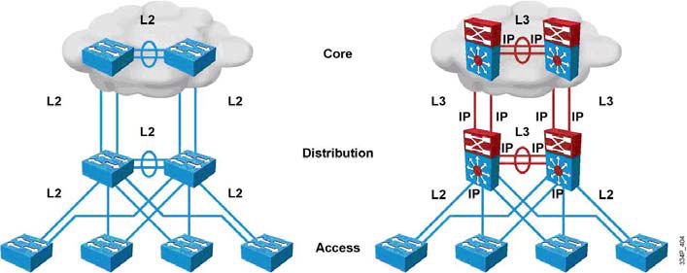
Routed/L3-Switched vs. L2 Switched Design
Routing can now be performed at L2 switching speeds by switching frames/packets using specialized hardware circuits.
L3 switches serve as default gateways, terminating VLANs (one IP subnet per VLAN).
Notes:
In the early days of switched networks, switching was fast (often at hardware speed) and routing was slow (routing had to be processed in software). This prompted network designers to extend the switched part of the network as much as possible. Access, distribution, and core layers were often partly configured to communicate at Layer 2. This architecture is referred as switched, as shown in the figure. This topology created loop issues. To solve these issues, spanning-tree technologies were used to prevent loops while still enabling flexibility and redundancy in inter-switch connections.
As network technologies evolved, routing became faster and cheaper. Today, routing can be performed at hardware speed. One consequence of this evolution is that routing can be brought down to the core and the distribution layers without impacting network performance. As many users are in separate VLANs, and as each VLAN is usually a separate subnet, it is logical to configure the distribution switches as Layer 3 gateways for the users of each access switch VLAN. This implies that each distribution switch must have IP addresses matching each access switch VLAN. This architecture is referred to as routed, as shown in the figure.
Implement L3 ports instead of L2 ports between the distribution and the core layer. Because dynamic routing protocols can dynamically adapt to any change in the network topology, this new topology also eliminates Layer 2 loops. Between access and distribution switches, where Layer 2 connections remain, Flex Link technology can be used to activate only one link at a time or Layer 2 EtherChannel can be used, thus removing the risk of loops and the need for spanning tree.

Slide 13
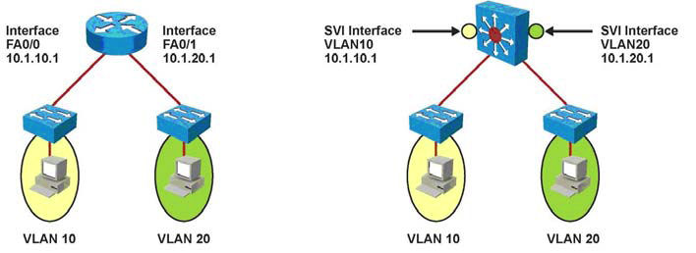
Switch Virtual Interfaces (SVI’s)
Configured on multilayer switches, one SVI per VLAN.
By default, an SVI is created for the default VLAN (VLAN 1), to permit remote switch administration.
The management interface on an L2 switch is an SVI, but an L2 switch is limited to one active SVI.
By default, when an SVI is created and enabled, the line state of an SVI with multiple ports on a VLAN is in the up state when it meets these conditions:
The VLAN exists and is active in the VLAN database on the switch.
The VLAN interface exists and is not administratively down.
At least one Layer 2 (access or trunk) port exists on the switch, has a link in the up state on this VLAN, and is in the spanning-tree forwarding state on the VLAN.
Notes:
An SVI is a virtual interface configured within a multilayer switch compared to external router configuration where the trunk is needed. An SVI can be created for any VLAN that exists on the switch. Only one VLAN associates with one SVI. An SVI is “virtual” in that there is no physical port dedicated to the interface, yet it can perform the same functions for the VLAN as a router interface would and can be configured in much the same way as a router interface (IP address, inbound/outbound ACLs, and so on). The SVI for the VLAN provides Layer 3 processing for packets to or from all switch ports associated with that VLAN.
By default, an SVI is created for the default VLAN (VLAN1) to permit remote switch administration. Additional SVIs must be explicitly created. SVIs are created the first time the VLAN interface configuration mode is entered for a particular VLAN SVI (for instance, when the command interface vlan # is entered). The VLAN number used corresponds to the VLAN tag associated with data frames on an 802.1Q encapsulated trunk or to the VLAN ID (VID) configured for an access port. For instance, if creating an SVI as a gateway for VLAN 10, name the SVI interface VLAN 10. Configure and assign an IP address to each VLAN SVI that is to route traffic off of and onto a VLAN. Whenever the SVI is created, make sure that particular VLAN is present in the VLAN database manually or learned via VTP. As shown in the figure, the switch should have VLAN 10 and VLAN 20 present in the VLAN database; otherwise, the SVI interface will stay down.
The following are some of the reasons to configure SVI:
To provide a gateway for a VLAN so that traffic can be routed into or out of that VLAN
To provide fallback bridging if it is required for non-routable protocols Note Using fallback bridging, non-IP packets can be forwarded across the routed interfaces, but this course focuses only on inter-VLAN routing, so only IP connectivity is discussed.
To provide Layer 3 IP connectivity to the switch
To support routing protocol and bridging configurations
SVI: Advantages and Disadvantages
The following are some of the advantage of SVI:
It is much faster than router-on-a-stick because everything is hardware switched and routed.
No need for external links from the switch to the router for routing.
Not limited to one link., Layer 2 EtherChannels can be used between the switches to get more bandwidth.
Latency is much lower because it doesn’t need to leave the switch.
The following is a disadvantage:
It needs a Layer 3 switch to perform Inter-VLAN routing, which is more expensive.

Slide 14
SVI: Advantages and Disadvantages
The following are some advantages of SVIs:
It is much faster than router-on-a-stick because everything is hardware switched and routed.
No need for external links from a switch to the router for routing.
Not limited to one link. Layer 2 EtherChannels can be used between the switches to get more bandwidth.
Latency is much lower because it does not need to leave the switch.
The following are some of the disadvantages:
it needs a layer 3 switch to perform inter-VLAN routing, which is more expensive (for example, catalyst 3500 series).

Slide 15
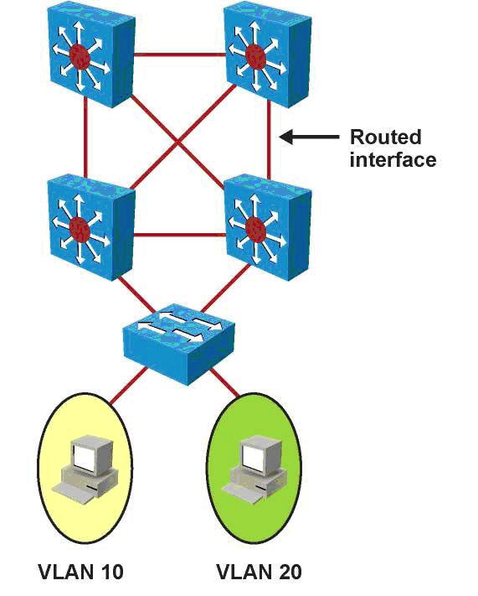
Routing with Routed Ports
A routed port is a physical port that acts similarly to a port on a traditional router.
Routed ports are not associated with a particular VLAN.
As layer 2 functionality has been removed, Layer 2 protocols such as STP and VTP do not function.
Routed interfaces do not support subinterfaces as with Cisco IOS routers.
Use the no switchport command to configure a physical switch port as a routed port.
Routed ports are used in conjunction with SVI’s.
Routed ports connect point-to-point (L3) links between distribution layer and core layer switches.
A 48-port L3 switch can be configured as a 48-port router.
Notes:
A routed port is a physical port that acts similarly to a port on a traditional router with Layer 3 addresses configured. Unlike an access port, a routed port is not associated with a particular VLAN. A routed port behaves like a regular router interface. Also, because Layer 2 functionality has been removed, Layer 2 protocols, such as STP and VTP, do not function on a routed interface. However, protocols such as LACP, which can be used to build either Layer 2 or Layer 3 EtherChannel bundles, would still function at Layer 3. Routed interfaces don’t support subinterfaces as with Cisco IOS routers. Routed ports are used for point-to-point links; connecting WAN routers and security devices are examples of the use of routed ports. In the campus switched network, routed ports are mostly configured between the switches in the campus backbone and between switches in the campus backbone and building distribution switches if Layer 3 routing is applied in the distribution layer. The figure illustrates routed ports for point-to-point links in a campus switched network.
To configure routed ports, make sure to configure the respective interface as a Layer 3 interface using the no switchport interface command, if the default configurations of the interfaces are Layer 2 interfaces as with the Catalyst 3560 family of switches. In addition, assign an IP address and other Layer 3 parameters as necessary. After assigning the IP address, make certain that IP routing is globally enabled and that applicable routing protocols are configured. The number of routed ports and SVIs that can be configured on a switch is not limited by software. However, the interrelationship between these interfaces and other features configured on the switch may overload the CPU due to hardware limitations, so a network engineer should fully consider these limits before configuring these features on numerous interfaces.
Following are some of the advantages of routed ports:
A multilayer switch can have SVIs and routed ports on a single switch.
Multilayer switches forward either Layer 2 or Layer 3 traffic in hardware.

Slide 16
Configuring Inter-VLAN Routing with SVI’s
Step 1. Specify an SVI by using a VLAN interface command:
Switch(config)# interface vlan vlan-id
Step 2. Assign an IP address to the VLAN:
Switch(config-if)# ip address ip_address subnetmask
Step 3. Enable the interface:
Switch(config-if)# no shutdown
Step 4. Enable IP routing on the Switch: (default)
Switch(config)# ip routing
Notes:
As previously discussed, before implementing inter-VLAN routing on a multilayer switch, a network engineer should plan the steps necessary to make it successful. Prior planning can help prevent any problems during the installation by logically organizing the necessary steps and providing checkpoints and verification, as necessary:
The first step is to identify the VLANs that require a Layer 3 gateway within the multilayer switch. It is possible that not all VLANs will require the capability to reach other VLANs within the enterprise. For example, a company might have a VLAN in use in an R&D laboratory. The network designer determines that this VLAN should not have connectivity with other VLANs in the enterprise or to the Internet. However, the R&DVLAN is not a local VLAN but spans the switch fabric due to the presence of an R&D server in the data center, so it cannot simply be pruned from the trunk between the multilayer switch and the R&D lab switch. Such a VLAN might be configured without a Layer 3 gateway as one way of ensuring the desired segregation.
If a VLAN that is to be routed by an SVI interface does not already exist on the multilayer switch, it must be created. Then create the SVI interface for each VLAN that needs to be routed within the multilayer switch.
Find out what protocols needs to be configured on the SVI; for example, IP and such. Assuming the enterprise uses only IP as a routed protocol, a network engineer would then configure each SVI interface with an appropriate IP address and mask. Following this, the SVI interface needs to be enabled using the no shutdown interface command.
If SVIs are used to provide Layer 3 forwarding services to their assigned VLAN (as opposed to only giving those VLANs the capability to reach the switch), all routed protocols in use in the enterprise must have their routing function enabled within the multilayer switch. (Layer 3 routing is not enabled by default in a multilayer switch.)
Depending on the size of the network and the design provided by the network architect, the multilayer switch might need to exchange dynamic routing protocol updates with one or more other routing devices in the network. A network engineer must determine whether this need exists, and if so, configure an appropriate dynamic routing protocol on the multilayer switch. The choice of protocol may be specified by the network designer, or the choice may be left to the network engineer.
Finally, after carefully considering the network structure, a network engineer can decide to exclude certain switchports from contributing to the SVI line-state up-and-down calculation. Any such switchports would be configured with the autostate exclude feature. Autostate is discussed more in the “SVI Autostate” section.
Note In addition, the number of VLANs and SVIs supported per Catalyst family is not always the same. For example, a switch can support 256 VLANs but only 64 SVIs (routed VLAN interfaces). Refer to Chapter 2 for details about the number of VLANs supported per Catalyst switch, and always refer to product release notes for the latest details about the number of VLANs and SVIs supported per Catalyst family of switch.
Note A routing protocol is only needed to communicate the VLANs subnets to other routers and is not essential to route between the SVIs on the same device, because SVIs are seen as connected interfaces.

Slide 17
Configuring Routed Ports
Step 1. Select the interface for configuration.
Switch(config)# interface interface-id
Step 2. Convert this port from a physical Layer 2 port to a physical Layer 3 interface.
Switch(config-if)# no switchport
Step 3. Configure the IP address and IP subnet mask. This address will be used by hosts on the segment connected to this interface for communication to the switch on this interface, or as the default gateway to other networks.
Switch(config-if)# ip address ip_address subnet_mask
Step 4. Enable IP routing on the router.
Switch(config)# ip routing
Step 5. (Optional.) Specify an IP routing protocol or use static routes:
Switch(config)# router ip_routing_protocol options
Notes:
To configure routed ports, make sure to configure the respective interface as a Layer 3 interface using the no switchport interface command, if the default configurations of the interfaces are Layer 2 interfaces as with the Catalyst 3560 family of switches. In addition, assign an IP address and other Layer 3 parameters as necessary. The rest of the steps are similar, as mentioned in the configuration of Inter-VLAN routing using SVI.
Note Entering the no switchport interface configuration command shuts down the interface and then reenables it, which might generate messages on the device to which the interface is connected. When you use this command to put the interface into Layer 3 mode, you delete any Layer 2 characteristics configured on the interface.

Slide 18
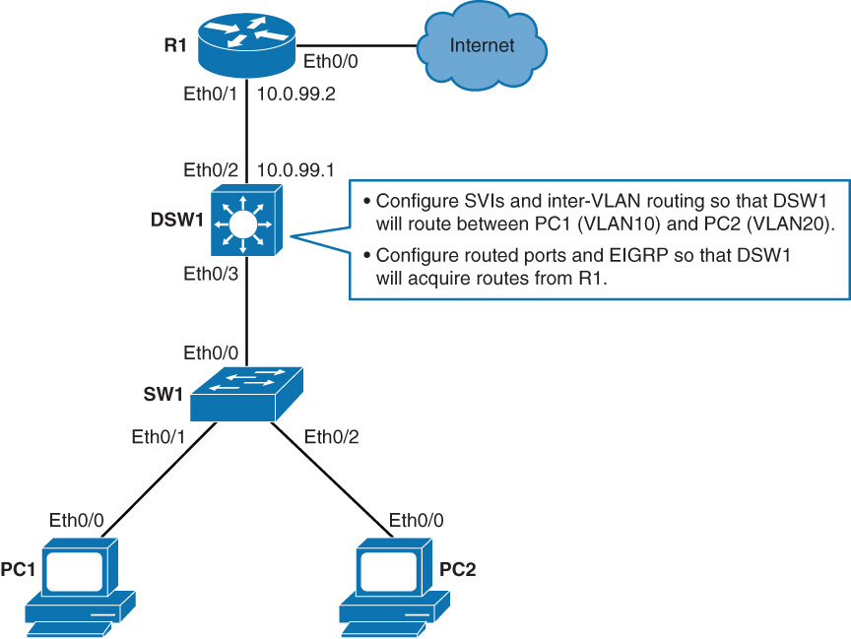
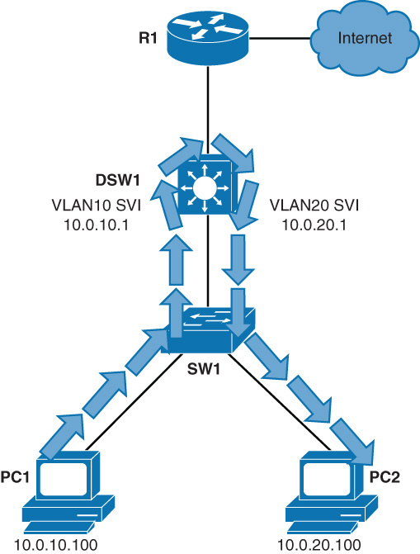
An Example of Configuring Inter-VLAN Routing
Device | Interface | IP Address
PC1 | Eth 0/0 | 10.0.10.100/24
PC2 | Eth 0/0 | 10.0.20.100/24
DSW1 | VLAN 10 | 10.0.10.1/24
DSW1 | VLAN 20 | 10.0.20.1/24
DSW1 | Eth 0/2 | 10.0.99.1/24
R1 | Eth 0/1 | 10.0.99.2/24
R1 | Eth 0/0 | 209.165.201.2/30
Server on the Internet | N/A | 209.165.201.1

Slide 19
Routing on a Multilayer Switch - Example
Step 1. On DSW1, create VLANs 10 and 20:
DSW1 (config)# vlan 10
DSW1 (config-vlan)# vlan 20
Step 2. On DSW1, enable IPV4 routing:
DSW1 (config)# ip routing
Step 3. On the DSW1, configure SVI for VLAN 10 with IP address 10.0.0.1/24.
DSW1 (config)# interface vlan 10
DSW1 (config-if)# ip address 10.0.10.1 255.255.255.0
DSW1 (config-if)# no shutdown
Step 4. On DSW1, configure SVI for VLAN 20 with IP address 10.0.20.1/24.
DSW1 (config)# interface vlan 20
DSW1 (config-if)# ip address 10.0.20.1 255.255.255.0
DSW1 (config-if)# no shutdown
Step 5. On DSW1, verify IP interface configuration for VLANs 10 and 20:
DSW1# show ip interface brief
Inteface IP-Address OK? Method Status Protocol
Vlan10 10.0.10.1 YES manual up up
Vlan20 10.0.20.1 YES manual up up
Step 6. Use traceroute to test connectivity between PC1 and PC2
PC1# traceroute 10.0.20.100
Type escape sequence to abort
Tracing the route to 10.0.20.100
VRF info:(vrf in name/id, vrf out name/id
1 10.0.10.1 1001 msec 1 msec 0 msec
2 * *
10.0.20.100 1 msec

Slide 20
Routing on a Multilayer Switch - Example
Step 7. On DSW1, turn the interface that connects to R1 (Ethernet 0/0) into a routed interface. Configure it with IP 10.0.99.1/24
DSW1 (config)# interface ethernet 0/2
DSW1 (config-if)# no switchport
DSW1 (config-if)# ip address 10.0.99.1 255.255.255.0
Step 8. On DSW1, verify the routed port interface configuration:
DSW1# show ip interface brief
Inteface IP-Address OK? Method Status Protocol
Ethernet0/0 unassigned YES unset up up
Ethernet0/1 unassigned YES unset up up
Ethernet0/2 10.0.99.1 YES manual up up
Vlan10 10.0.10.1 YES manual up up
Vlan20 10.0.20.1 YES manual up up
Step9. On DSW1, configure EIGRP with AS1. Enable VLAN10, VLAN20 and Ethernet 0/2 interfaces for EIGRP.
DSW1(config)# router eigrp 1
DSW1(config-router)# network 10.0.0.0
Step 10. Verify the routing table on DSW1:
DSW1# show ip route
<… output omitted …>
D#EX 0.0.0.0/0 (170/307200) via 10.0.99.2 00:07:13, Ethernet 0/2
10.0.0.0/8 is variably subnetted, 6 subnets, 2 masks
<… output omitted …>

Slide 21
Using the autostate exclude Command
The SVI interface is brought up when one layer to port in the VLAN has had time to converge.
The default action when the VLAN has multiple ports is that the SVI goes down when all ports on the VLAN go down.
This action prevents features such as routing protocols from using the VLAN interface as if it were fully operational and minimizes other problems,problems such as routing black holes.
You can use the SVI autostate exclude command to configure a port so that it is not included in the SVI line state up-and-down calculation.
An example is if you are doing traffic capturing through a network analyzer. This port does not need to be an active participant in the vlan assigned to the interface.
Step 1. Select the interface for configuration:
Switch (config-if)# switchport autostate exclude

Slide 22
SVI Configuration Checklist
Identify which VLANs require a Layer 3 Gateway.
Create a VLAN on a multilayer switch if it does not already exist.
Create an SVI interface for each VLAN.
Configure the SVI interface with an IP address.
Enable the SVI interface.
Enable IP routing on the multilayer switch.
Determine whether a dynamic routing protocol is needed.
Configure a dynamic routing protocol if needed.
Identify any switch ports that require autostate exclude.
Configure autostate exclude on identified switch ports

Slide 23
Inter-VLAN Routing Verification (1)
Verify the status of an SVI.
Switch# show interfaces vlan 20
Vlan20 is up, line protocol is up
Hardware is Ethernet SVI, address is 00D.588F.B604 (bia 00D.588F.B604)
Internet address is 10.1.20.1/24
MTU 1500 bytes, BW 1000000 Kbit, DLY 10 usec,
reliability 255/255, txload 1/255, rxload 1/255
Encapsulation ARPA, loopback not set
ARP type: ARPA, ARP Timeout 04:00:00
Last input never, output never, output hang never
Last clearing of “show interface” counters never
Input queue: 0/75/0/0 (size/max/drops/flushes); Total output drops: 0
Queueing strategy: fifo
Output queue: 0/40 (size/max)
5 minute input rate 0 bits/sec, 0 packets/sec
5 minute output rate 0 bits/sec, 0 packets/sec
0 packets input, 0 bytes, 0 no buffer
Received 0 broadcasts, 0 runts, 0 giants, 0 throttles
0 input errors, 0 CRC, 0 frame, 0 overrun, 0 ignored
0 packets output, 0 bytes, 0 underruns
0 output errors, 0 interface resets
0 output buffer failures, 0 output buffers swapped out
Notes:
The verification commands are similar across any inter-VLAN routing methods. The following commands are useful to inter-VLAN routing verifications:
show ip interface interface_type_port | svi_number
show interface interface_type_port | svi_number
show running interface type_port | svi_number
Ping
show vlan
show interface trunk
The show interfaces command can be used to display the interface IP address configuration and status of a port. The command can also displays SVI interface status, EtherChannel interface status, or a port status and its configuration. This example shows the output of the show interfaces vlan command.
The SVI interface for VLAN 20 shows a status of up/up because at least one port is active in VLAN 20. Note that the hardware is reported as Ethernet SVI indicating the virtual nature of the interface. The remainder of the output is similar to what would be seen on any router interface.

Slide 24
Inter-VLAN Routing Verification (2)
Display the interface configuration of a routed port.
Switch# show running-config interface FastEthernet 2/8
Building configuration...
!
interface FastEthernet2/8
no switchport
ip address 172.16.22.2 255.255.255.252
<output omitted>
Notes:
The show running-config command can be used to display the interface configuration of a Layer 3 routed interface. In Example 4-5, the interface is configured as a Layer 3 routed interface, as evident by the disabling of Layer 2 functionality through use of the no switchport command. Recall that the 30-bit mask means two IP addresses exist in that subnet, which means the switch interfaces might be connecting to only a single external device on this subnet, such as a router or firewall.

Slide 25
Inter-VLAN Routing Verification (3)
Display the IP properties on a routed port.
Switch# show ip interface fastethernet0/24
FastEthernet0/24 is up, line protocol is up
Internet address is 10.1.10.1/24
Broadcast address is 255.255.255.255
Address determined by setup command
MTU is 1500 bytes
Helper address is not set
Directed broadcast forwarding is disabled
Multicast reserved groups joined: 224.0.0.10
Outgoing access list is not set
Inbound access list is not set
Proxy ARP is enabled
Local Proxy ARP is disabled
Security level is default
Split horizon is enabled
ICMP redirects are always sent
ICMP unreachables are always sent
ICMP mask replies are never sent
IP fast switching is enabled
IP CEF switching is enabled
Notes:
In addition to this, the network administrator can use the show ip interface command to check and verify the IP properties configured on the ports.
As shown in the example, interface fasthethernet0/24 is a routed port with the IP address 10.1.10.1.
After the router is properly configured and is connected to the network, it can communicate with other nodes on the network. To test IP connectivity to hosts, use the ping command.

Slide 26
Troubleshooting Inter-VLAN Problems
To troubleshoot inter-VLAN routing issues, the following are some checkpoint implementations:
Correct VLANs on switches and trunks.
Correct routes.
Correct primary and secondary bridges.
Correct IP address and subnet masks.

Slide 27
Common Inter-VLAN Routing Problems
Problem | Possible Cause
Missing VLAN | VLAN might not be defined across all the switches. VLAN might not be enabled on the trunk ports. Ports might not be in the right VLANs.
Layer 3 interface configuration | Virtual interface might have the wrong IP address or subnet mask. Virtual interface might not be up. Virtual interface number might not be match with the VLAN number. Routing has to be enabled to route frames between VLAN. Routing might not be enabled.
Routing protocol misconfiguration | Every interface or network needs to be added in the routing protocol. The new interface might not be added to the routing protocol. Routing protocol configuration is needed only if VLAN subnets needs to communicate to the other routers, as previously mentioned in this chapter.
Host misconfiguration | Host might not have the right IP or subnetmask. Each host has to have the default gateway that is the SVI or Layer 3 interface to communicate the other networks and VLAN. Host might not be configured with the default gateway.

Slide 28
Troubleshooting Inter-VLAN Example
A company XYZ is adding a new floor to the current network, and based on this, the current requirements are; to make sure the users on the new floor 5 can communicate with users on other floors.
The current issue is that users on floor 5 cannot communicate with user on the other floor.
Following is the example of the implementation plan to install a new VLAN for their use and make sure it is routing to other VLANs.
Your implementation plan lists the following steps:
Step 1. Create a new VLAN 500 on the fifth floor switch and on the distribution switches. Name it Accounting department.
Step 2. Identify the ports needed for the users and switches. Set the switchport access VLAN command to 500, and make sure the trunk is configured using the configuration mentioned in Chapter 2 between the switches, and VLAN 500 is allowed on the trunk.
Step 3. Create an SVI interface on the distribution switches and make sure the IP address are assigned.
Step 4. Verify connectivity.

Slide 29
Troubleshooting Plan
If a new VLAN has been created:
Was the VLAN created on all the switches?
If VTP is configured, make sure VLANs are defined on the VTP server and are getting propagated across all the domains.
Verify with a show vlan command.

Slide 30
Troubleshooting Plan
Make sure ports are in the right VLAN and trunking is working as expected:
Did all access ports get the command switchport access vlan 500 added?
Were there any other ports that should have been added? If so, make those changes.
Were these ports previously used? If so, make sure there are no extra commands enabled on these ports that can cause conflicts. If not, is the port enabled?
Are the access ports set to switchport access and not trunks? If not, issue the command switchport mode access.
Are the trunk ports set to trunk mode and manually prune all the VLAN.
Is manual pruning of VLANs a possibility? If so, make sure that the trunks necessary to carry this VLAN traffic have the VLAN in the allowed statements.

Slide 31
Troubleshooting Plan
If SVI interfaces are created:
Is the VLAN virtual interface already created with the correct IP address and subnet mask? Is it enabled?
Is the routing enabled?
Is this SVI added in the routing protocol
Verify connectivity.
Are all the links between the different switches on the path enabling this VLAN to be transported?
Are all the links between switches in trunk mode?
Is this VLANs allowed on all trunks?
Is spanning-tree blocking one of those links?
Are the ports enabled?
Does the host have the right default gateway assigned.
Also make sure the default route or some routing protocol is enabled if it needs to talk to other routers.

Slide 32
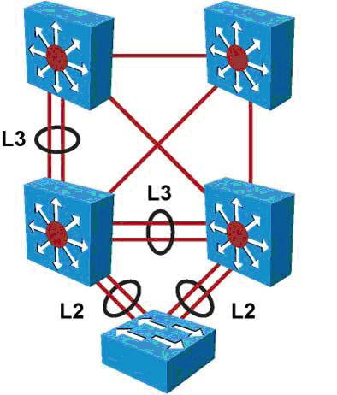
L3 EtherChannels
Just as with physical interfaces on multilayer switches, bundles of interfaces (port channels) can be configured as routed ports.
Port channels configured as routed ports are called L3 EtherChannels.
L2 EtherChannels are normally used only when connecting from an access layer switch.
Notes:
The EtherChannel technology is available to bundle ports of the same type. On a Layer 2 switch, EtherChannel can aggregate access ports such as servers that support EtherChannel or trunk links to connect switches. As each EtherChannel link is seen as one logical connection, ports that are member of an EtherChannel can load balance traffic on all the links that are up. On Layer 3 switches, switched ports can be converted to routed ports. These ports do not perform switching at Layer 2 anymore, but become Layer 3 ports similar to those found on router platforms. Routed Layer 3 ports can also form EtherChannel just like Layer 2. On a multilayer switch, it is easy to configure Layer 2 EtherChannels or Layer 3 EtherChannels, depending on what type of devices connect and depending on their position in the network. The configuration requires that ports on both sides are configured the same way: switch ports (access or trunk) or routed ports. In the figure, the bottom switch is Layer 2-only because it is an access switch, so Layer 2 EtherChannel is configured. At the distribution or the core layer, where Layer 3 links are recommended, Layer 3 EtherChannels are configured.

Slide 33
Configuring Layer 3 EtherChannels
Step 1. Create a virtual Layer 2 interface.
Switch(config)# interface port-channel 1
Step 2. Convert to a Layer 3 interface to enable IP configuration.
Switch(config-if)# no switchport
Step 3. Assign an IP address to the port-channel interface:
Switch(config-if)# ip address ip_address subnet_mask
Step 4. Navigate to the interfaces that are to be associated with the EtherChannel bundle:
Switch(config)# interface range interface_id portnumber_range
Step 5. For a Layer 3 EtherChannel to form, the associated physical ports must be configured as Layer 3 ports. Assign the interfaces to the EtherChannel group:
Switch(config-if-range# no switchport
Switch(config-if-range)# channel-group channel-group-number mode {auto [non-silent] | desirable [non-silent] | on} | {active | passive}
Notes:
Make sure the channel mode is set up right on both sides. Depending on the mode, the EtherChannel can use LACP or PAgP (as discussed in Chapter 2).
Note It is important to match the EtherChannel configuration on both sides on the switches, and the IP addresses on the port-channel interfaces should be on the same subnets/VLAN to communicate.

Slide 34
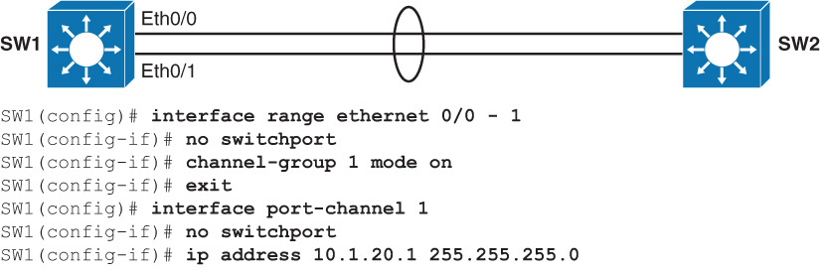
Layer 3 EtherChannel Configuration

Slide 35
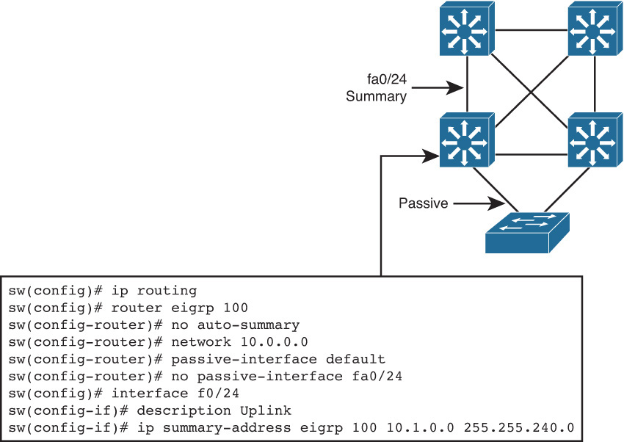
Routing Protocol Configuration
Notes:
Routing Protocol Configuration
As soon as a multilayer switch is configured with Layer 3 IP addresses, it starts behaving like a router in the sense that it has connections to different subnets. Communication between these subnets can no longer be achieved using Layer 2 protocols. A major difference between a multilayer switch and a router is that a multilayer switch does not route until some Layer 3 or SVI interfaces are created. When routing is enabled, the network administrator configures static routes and dynamic routing, just like on a router, as shown in the figure. Here EIGRP is configured. Notice the passive interface commands. On a Layer 3 switch, a common recommendation is to enable dynamic routing only on those interfaces that need to exchange routing information with neighbors. Wherever needed, summarization should also be configured to limit the size of the routing tables.

Slide 36
Verifying Routing (1)
Switch# show ip route
Codes: C - connected, S - static, R - RIP, M - mobile, B - BGP
D - EIGRP, EX - EIGRP external, O - OSPF,
IA - OSPF inter area
N1 - OSPF NSSA external type 1,
N2 - OSPF NSSA external type 2
E1 - OSPF external type 1, E2 - OSPF external type 2
i - IS-IS, su - IS-IS summary, L1 - IS-IS level-1,
L2 - IS-IS level-2
ia - IS-IS inter area, * - candidate default,
U - per-user static route
o - ODR, P - periodic downloaded static route
Gateway of last resort is not set
10.0.0.0/8 is variably subnetted, 13 subnets, 2 masks
D 10.1.3.0/24 [90/28416] via 10.1.10.10, 08:09:49, Vlan10
D 10.1.2.0/24 [90/28416] via 10.1.10.10, 08:09:49, Vlan10
C 10.1.10.0/24 is directly connected, Vlan10
Notes:
Verifying Routing Protocol
To verify whether the routing protocol is working as expected, use the show ip route and show ip protocol commands. On a Layer 3 switch, just like on a router, use the show ip route command to display which Layer 3 routes are known to the local multilayer switch, as shown in Example 4-7. Each route type is identified by a code D, for example, which means routes are learned via EIGRP. In Example 4-7, the 10.1.10.0/24 subnet is directly connected (which can be identified with the letter C at the left of the route); the other routes are known via EIGRP (which can be identified with the letter D at the left of the route). Both 10.1.2.0/24 and 10.1.3.0/24 subnets are learned via 10.1.10.10. Their administrative distance is 90, and the cost to each of these networks is 28416. The link to 10.1.10.10 goes through the VLAN 10 interface. Notice that VLAN 10 here is the name of the SVI, the Layer 3 interface, through which the networks are reachable.

Slide 37
Verifying Routing (2)
Switch# show ip protocol
Routing Protocol is “eigrp 1”
Outgoing update filter list for all interfaces is not set
Incoming update filter list for all interfaces is not set
Default networks flagged in outgoing updates
Default networks accepted from incoming updates
EIGRP metric weight K1=1, K2=0, K3=1, K4=0, K5=0
EIGRP maximum hopcount 100
EIGRP maximum metric variance 1
Redistributing: eigrp 1
Automatic network summarization is in effect
Maximum path: 4
Routing for Networks:
10.0.0.0
Passive Interface(s):
Vlan1
Vlan11
Routing Information Sources:
Gateway Distance Last Update
10.100.117.202 90 20:25:10
10.100.113.201 90 20:25:10
Distance: internal 90 external 170
Notes:
The show ip protocol command shows information about the routing protocols that are enabled on the switch or router.

Slide 38

Implementing Dynamic Host Configuration in a Multilayer Switched Environment
Notes:
This section focuses on the following objectives:
DHCP operation
DHCP configuration and verification

Slide 39
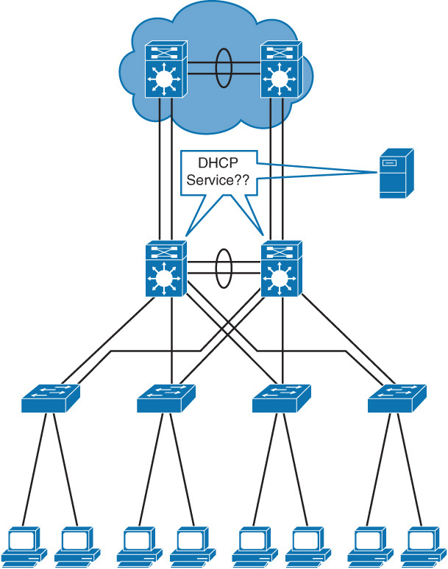
DHCP Overview
As defined in RFC 2131, DHCP provides configuration parameters to Internet hosts.
DHCP consists of two components: a protocol for delivering host–specific configuration parameters from a DHCP server to a host, and a mechanism for allocating network addresses to hosts.
DHCP is built on a client/server model in which designated DHCP server hosts allocate network addresses and deliver configuration parameters dynamically configured hosts.

Slide 40
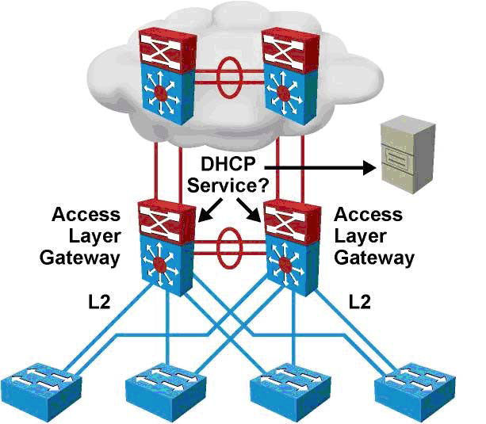
DHCP Overview
Distribution multilayer switches often act as Layer 3 gateways for clients connecting to the access switches on various VLANs.
Therefore, the DHCP service can be provided directly by the distribution switches.
Alternatively, DHCP services can be concentrated in an external, dedicated DHCP server.
In that case, distribution switches need to redirect the incoming clients DHCP requests to the external DHCP server.
Notes:
As defined in RFC 2131, Dynamic Host Configuration Protocol (DHCP) provides configuration parameters to Internet hosts. DHCP consists of two components: a protocol for delivering host-specific configuration parameters from a DHCP server to a host, and a mechanism for allocating network addresses to hosts. DHCP is built on a client/server model in which designated DHCP server hosts allocate network addresses and deliver configuration parameters to dynamically configured hosts. By default, Cisco multilayer switches running Cisco IOS Software include DHCP server and relay agent software.

Slide 41
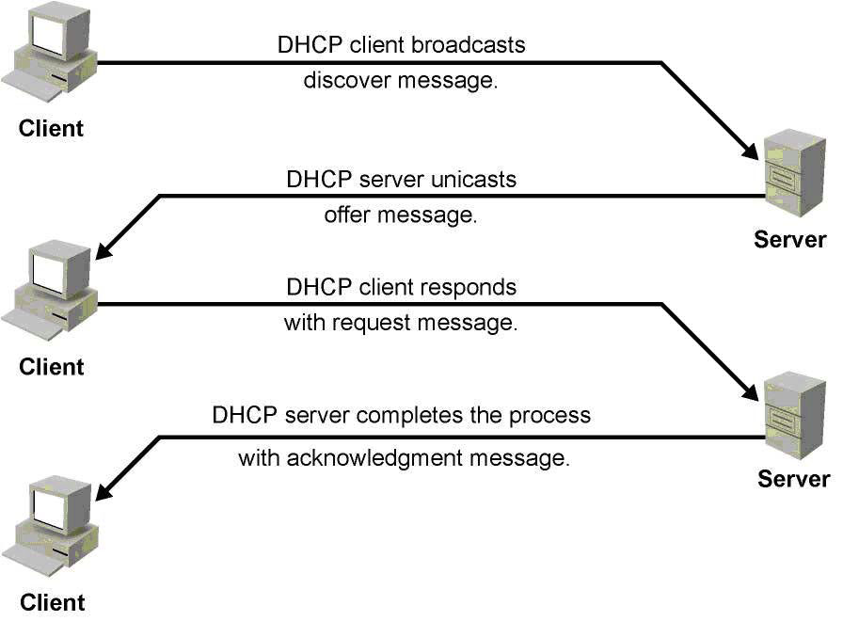
DHCP Operation
Step 1. The client sends a DHCPDISCOVER broadcast message to locate a Cisco IOS DHCP server.
Step 2. A DHCP server offers configuration parameters (such as an IP address, a MAC address, a domain name, and a lease for the IP address) to the client in a DHCPOFFER unicast message. A DHCP client might receive offers from multiple DHCP servers and can accept any one of the offers; however, the client usually accepts the first offer it receives. Additionally, the offer from the DHCP server is not a guarantee that the IP address will be allocated to the client; however, the server usually reserves the address until the client has had a chance to formally request the address.
Step 3. The client returns a formal request for the offered IP address to the DHCP server in a DHCPREQUEST broadcast message.
Step 4. The DHCP server confirms that the IP address has been allocated to the client by returning a DHCPACK unicast message to the client.

Slide 42
Configuring DHCP
Step 1. Create a pool with the ip dhcp pool command.
Step 2. Within the dhcp pool configuration submode, configure the network value, which indicates in which subnet addresses are offered. Also, configure items such as the default-gateway, lease duration, subnetmask, and DNS server IP addresses, among others.
Step 3. By default, the switch offers addresses taken from the whole range. To exclude some addresses, in global configuration mode, use the ip dhcp excluded-address command followed by the range of addresses to exclude from the DHCP offers. For a discontinuous address range, configure excluded addresses for each DHCP scope.
Switch(config)# ip dhcp excluded-address 10.1.10.1 10.1.10.20
Switch(config)# ip dhcp pool XYZ10
Switch(config-dhcp)# network 10.1.10.0 255.255.255.0
Switch(config-dhcp)# default-router 10.1.10.1
Switch(config-dhcp)# option 150 10.1.1.50
Switch(config-dhcp)# lease 0 8 0
Switch(config-dhcp)# ! 0 days 8 hours 0 minutes
Switch(config)# interface vlan10
Switch(config-if)# ip address 10.1.10.1 255.255.255.0
Notes:
The DHCP server can be configured on the router/multilayer switches or reside on the external server, and the multilayer switch or router can act as a DHCP relay agent.
A last important point to notice is that a multilayer switch can only offer IP addresses for a subnet in which it has an IP address. In other words, the switch configuration above precludes the offering of IP addresses in a 10.1.10.0/24 subnet if the switch itself does not have an IP address in this subnet. After this Layer 3 address is configured, all devices connecting to the switch through this interface can request an IP address. If the Layer 3 interface is a router port, all devices connecting to this routed port can request a DHCP IP address. If the Layer 3 interface in an SVI, all devices in the SVI VLAN, in this scenario VLAN 10, can request a DHCP IP address. Displayed is the configuration of DHCP on the switch for VLAN 10 with subnet 10.1.10.0. With the DHCP request, it shares the default gateway and lease information.

Slide 43
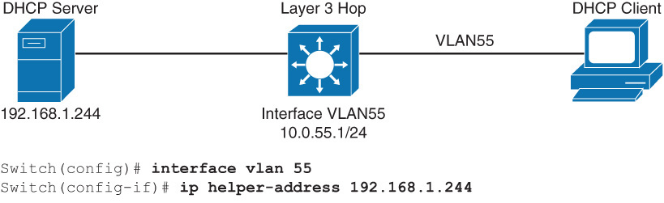
DHCP Relay
Use the ip helper-address command on the interface which connects to the subnet containing devices which request IP addresses from the DHCP server.
On a multilayer switch, the interface “connecting” to the relevant subnet is typically an SVI.
For IPv6 use the command ipv6 dhcp relay destination IPv6-address
Notes:
DHCP is a client-server application, in which the DHCP client, usually a desktop computer, contacts a DHCP server for configuration parameters using a broadcast request. Today’s enterprise networks consist of multiple VLANs, where inter-VLAN routing routes between the subnetworks.
Because Layer 3 devices do not pass broadcasts by default, each subnet requires a DHCP server unless the routers are configured to forward the DHCP broadcast using the DHCP relay agent feature using ip helper-address command. The ip helper-address command not only forwards DHCP UDP packets but also forwards TFTP, DNS, Time, NetBIOS, name server, and BOOTP packets by default.
As illustrated, an ip helper-address command must be configured under the multilayer switch Layer 3 interface. This ip helper-address command points to the corporate DHCP server IP address, 10.1.100.1. When the switch receives a DHCP request broadcast message from a client, the switch forwards this request, as a unicast message, to the IP address specified under the ip helper command. With this feature, the switch relays the dialog between the DHCP client and the DHCP server. When the switch receive the packets, it makes sure it assign an IP address only from the range of the subnet in which the client resides.

Slide 44
Configuring DHCP Options
Advanced configuration parameters and other control information are carried in trade data items, also known as DHCP options.
The following are some of the commonly used options.
Option 43: vendors encapsulated option that enables vendors to have their own list of options on the server. For example, you can use to tell a lightweight access point where the wireless LAN controller (WLC) is.
Option 69: SMTP server, if you want to specify available SMTP servers to the clients.
Option 70: POP3 server, if you want to specify available POP3 servers to the client.
Option 150: TFTP server that enables your phones to access our list of TFTP servers.

Slide 45
Verifying and Troubleshooting DHCP
Switch# show ip dhcp binding
Bindings from all pools not associated with VRF:
IP address Client-ID/ Lease expiration Type
Hardware address/
User name
10.1.10.21 0100.1bd5.132a.d2 Jun 25 2009 06:09 AM Automatic
10.1.10.22 0100.4096.a46a.90 Jun 25 2009 09:40 AM Automatic
10.1.10.23 0100.4096.aa98.95 Jun 25 2009 11:28 AM Automatic
Switch# debug ip dhcp server packet
DHCPD: DHCPDISCOVER received from client 0100.1bd5.132a.d2 on interface Vlan6.
DHCPD: Sending DHCPOFFER to client 0100.1bd5.132a.d2 (10.1.10.21).
DHCPD: broadcasting BOOTREPLY to client 001b.d513.2ad2.
DHCPD: DHCPREQUEST received from client 0100.1bd5.132a.d2.
DHCPD: Sending DHCPACK to client 0100.1bd5.132a.d2 (10.1.10.21).
DHCPD: broadcasting BOOTREPLY to client 001b.d513.2ad2.
Notes:
To verify the DHCP operation, use the following two commands:
show ip dhcp binding
debug ip dhcp server packet
The output of the command show ip dhcp binding displays the IP address assigned by the DHCP service on the switch and information regarding the IP addresses such as lease, MAC address, and so on.
DHCP debugs are used to verify the DHCP services on the switch. Here a client with mac-address 0100.1bd5.132a.d2 sends the request on VLAN 6. The DHCP server responds with the IP address 10.1.10.21, and then clients send the acceptance and DHCP services reply with the acknowledgment.

Slide 46
Resources
www.cisco.com/en/US/docs/switches/lan/catalyst3560/software/release/12.2_52_se/command/reference/3560cr.html
Configuring IP Unicast Routing Configuration Guide:
www.cisco.com/en/US/docs/switches/lan/catalyst3560/software/release/12.2_52_se/configuration/guide/swi
Configuring EtherChannels:
www.cisco.com/en/US/docs/switches/lan/catalyst3560/software/release/12.2_52_se/configuration/guide/swethchl.htmlprout.html
Configuring DHCP:
www.cisco.com/en/US/docs/switches/lan/catalyst3560/software/release/12.2_52_se/configuration/guide/swdhcp82.html

Slide 47


